Slide 1

PROJECT WORK
LYRICS FINDER
FOP
ZHAKUPOVA ZARINA
190109013

Slide 2

THE GOAL OF
THE PROJECT
CREATE A PROGRAM THAT WILL PROVIDE THE USER WITH THE REQUESTED LYRICS

Slide 3

make a graphical interface that will be convenient to use.
project objectives
find a site that fulfills our goal.
import libraries with the help of our website will be parsed.

Slide 4
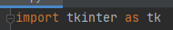
TKINTER
TKINTER IS THE STANDARD GUI LIBRARY FOR PYTHON. TKINTER PROVIDES VARIOUS CONTROLS, SUCH AS BUTTONS, LABELS AND TEXT BOXES USED IN A GUI APPLICATION. THESE CONTROLS ARE COMMONLY CALLED WIDGETS. SO, GO CREATE IT!

Slide 5
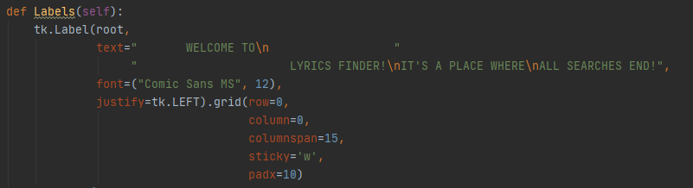
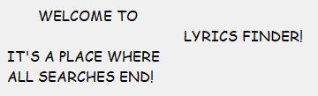
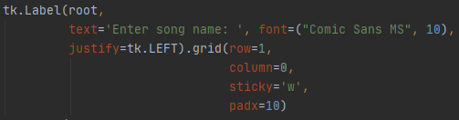
WORK WITH TKINTER (LABEL)

Slide 6
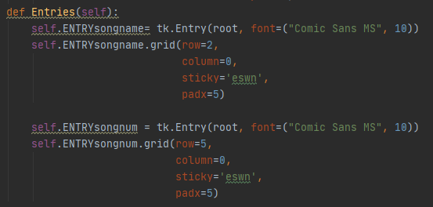
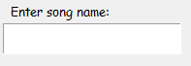
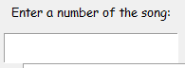
E N T R Y

Slide 7
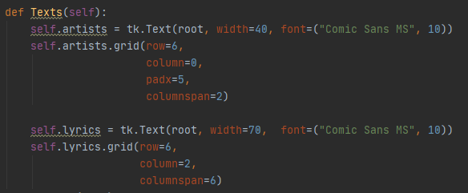
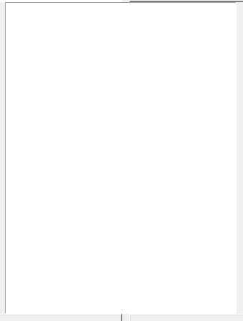
T E X T

Slide 8
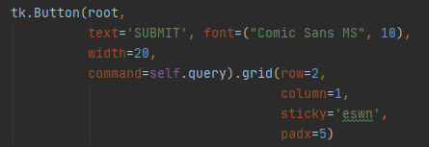
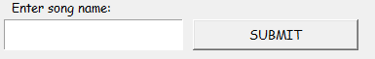
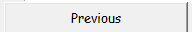
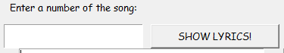
B
U
T
T
O
N

Slide 9

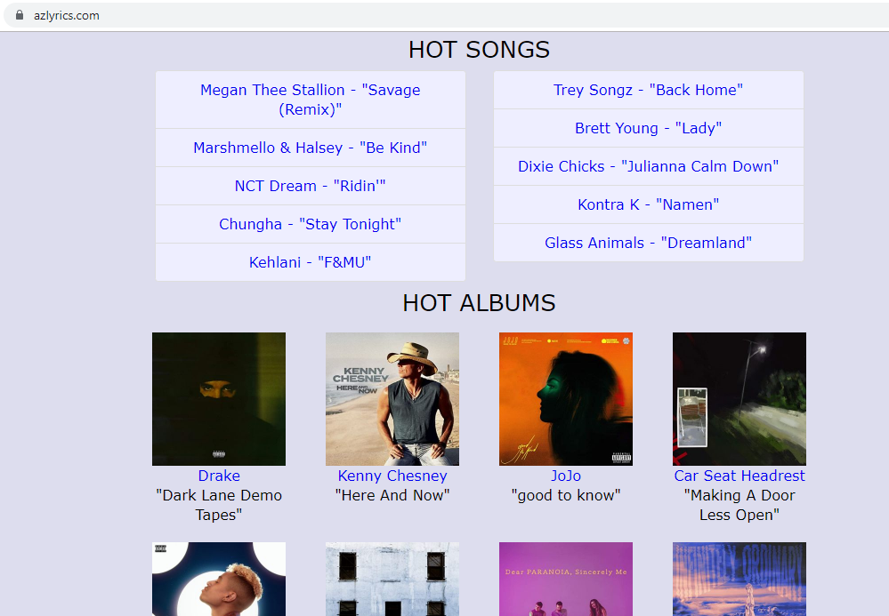
find our website and explore
the html code for parsing

Slide 10
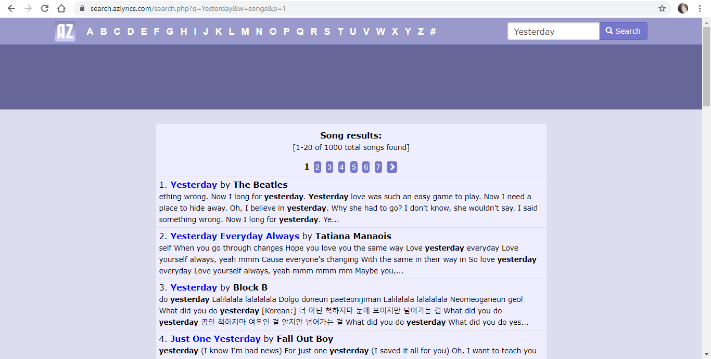

Slide 11

WE NEED TO SHOW THIS LIST OF SONGS SO THAT THE USER SELECTS WHAT HE IS LOOKING FOR. THEN SHOW THE LYRICS OF THIS SONG. FOR THIS WE USE LIBRARIES AS A BEAUTIFUL SOUP AND
REQUESTS. BEAUTIFUL SOUP IS A LIBRARY THAT MAKES IT EASY TO SCRAPE INFORMATION FROM WEB PAGES. REQUESTS LIBRARY ALLOWS US TO INTERACT WITH WEB APPLICATIONS WITH A MINIMUM AMOUNT OF CODE.

Slide 12
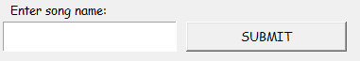
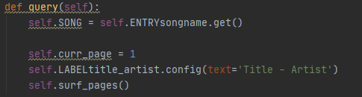



Slide 13
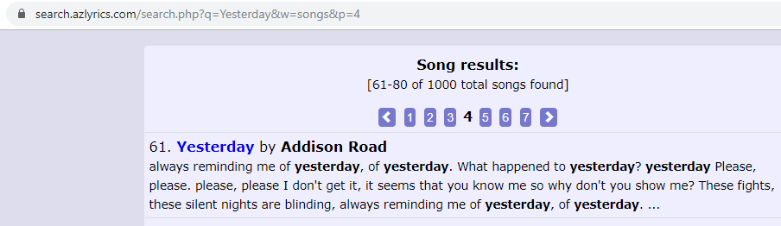
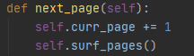
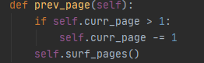


Slide 14
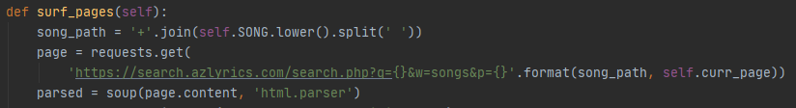


Slide 15
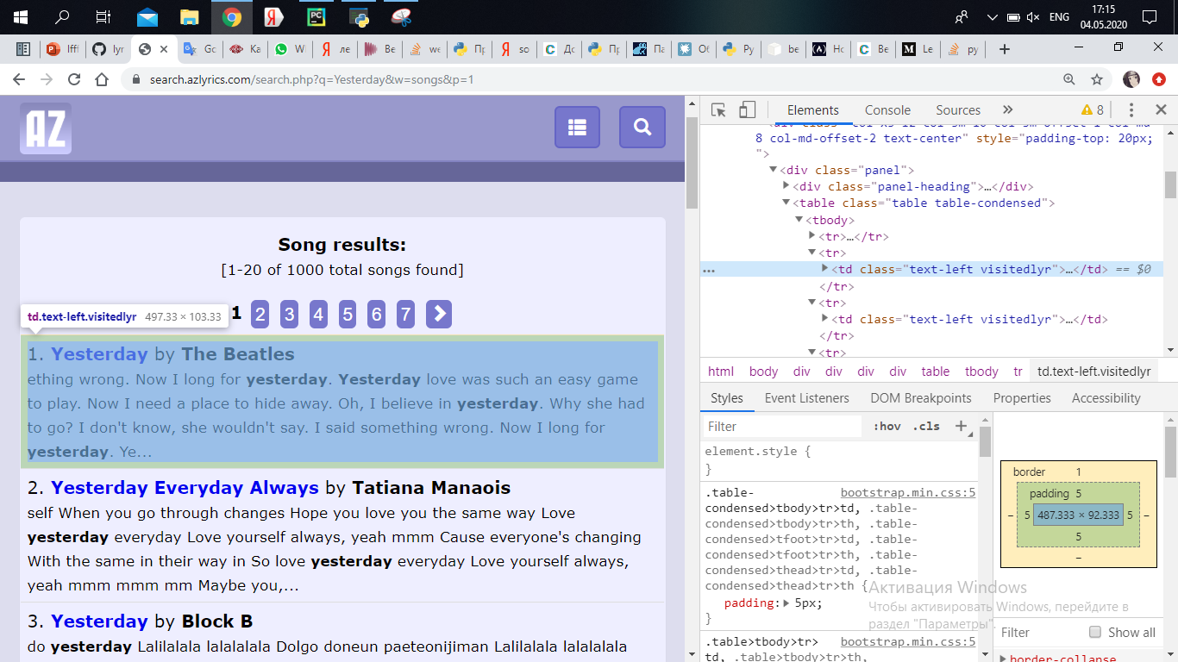

Slide 16
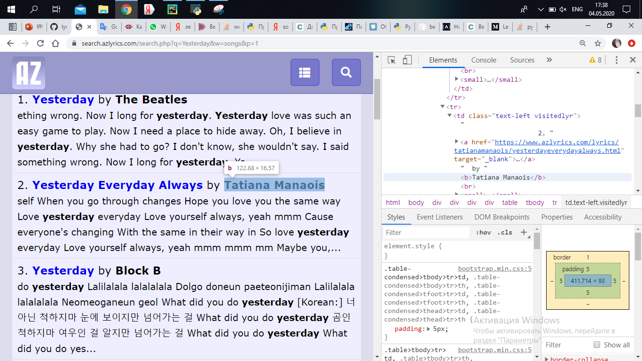

Slide 17
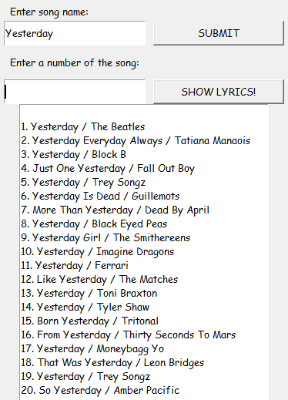
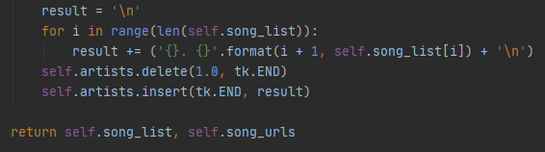

Slide 18
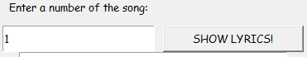
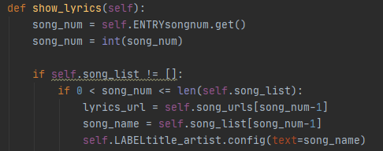

Slide 19
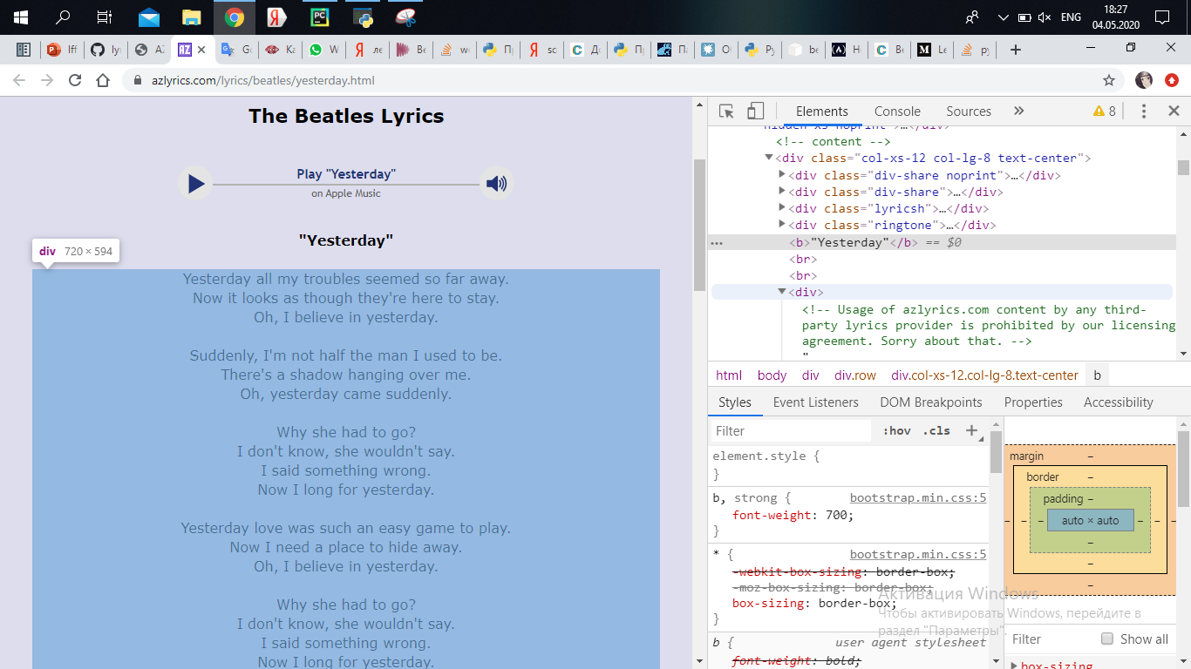

Slide 20

scraping is over
let's run the project

Slide 21

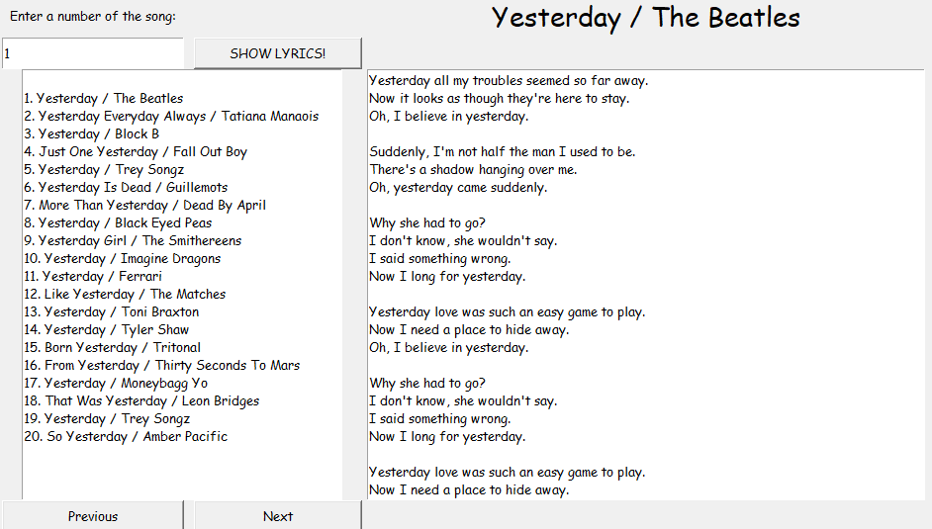




Slide 22
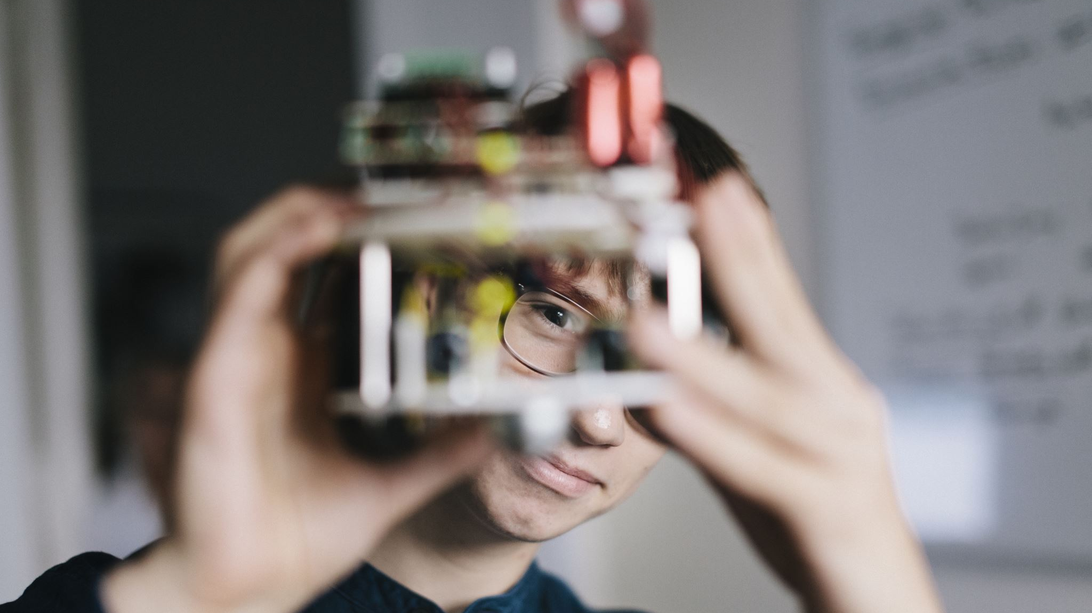
The
end

Slide 23

https://habr.com/en/sandbox/132503/
https://proglib.io/p/parsing-course
https://pythonru.com/uroki/obuchenie-python-gui-uroki-po-tkinter
https://metanit.com/python/tutorial/9.5.php
https://younglinux.info/tkinter/widget.php
file:///Z:/chalyshma/Fundamentals%20of%20Programming/byteofpython_120.pdf
https://stackoverflow.com/questions/46860838/web-scraping-python-beautifulsoup-requests

